Slide 1
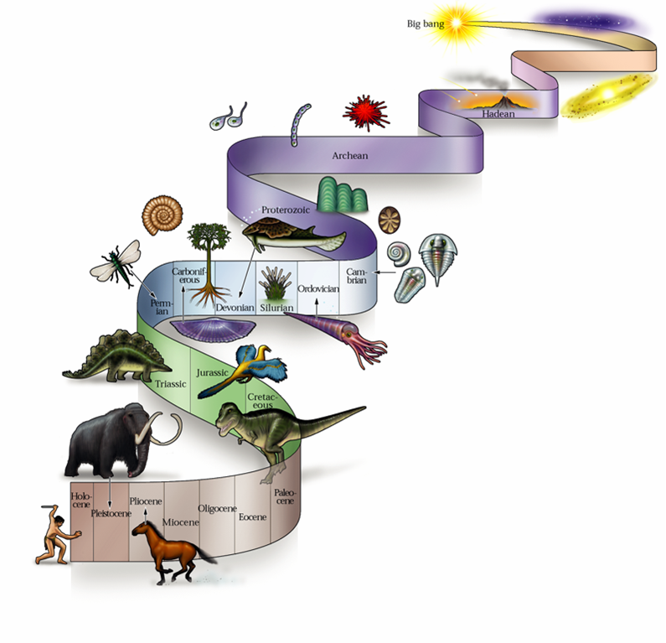
Evolution: How does it happen?

Slide 2
There are 5 processes that lead to evolution:
Mutation
Natural Selection
Genetic Drift
Non-random mating
Gene Flow

Slide 3
Mutation
A mutation is any change in the DNA sequence of an organism.
Mutations can be neutral, deleterious, or advantageous.
Mutations increase the variation in the gene pool of a species
(GENE POOL: all genes available to be passed on to the next generation)
What is a gene?

Slide 4
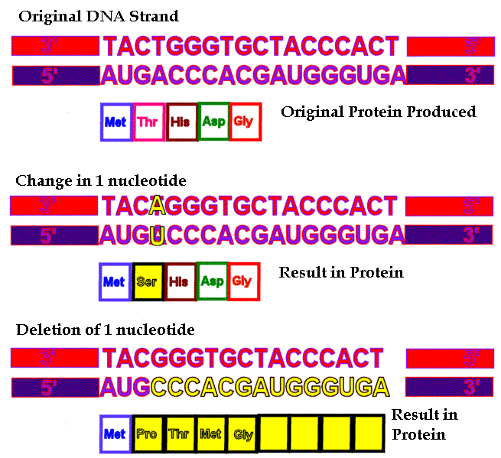

Slide 5
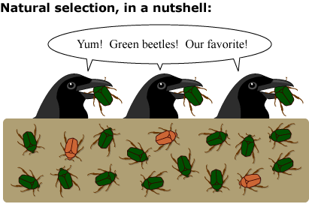
Natural Selection
A deliberate process in which organisms best suited for the environment are more likely to survive and reproduce.
Over generations organisms with the advantageous traits make-up a greater proportion of the population.

Slide 6
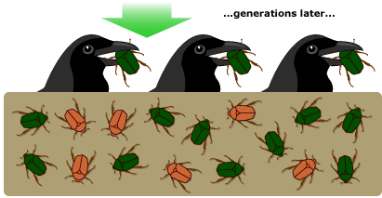

Slide 7
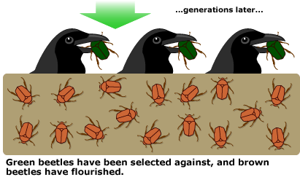

Slide 8
Genetic Drift
Change in gene frequency due to chance, such as a natural disaster
(GENE FREQUENCY: the ratio of alleles within a gene pool)
This reduces the variation in a population and can result in gene fixation
(GENE FIXATION: Only one allele for a trait is present in the gene pool)
Genetic drift is a random process - the allele that becomes fixed may or may not be beneficial to the population.

Slide 9
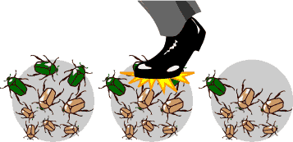
GENE
FREQUENCY
BEFORE
GENE
FREQUENCY
AFTER

Slide 10
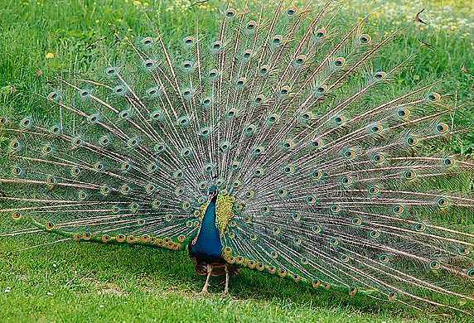
Non-Random Mating
The selection of a mate based upon a specific trait
eg. Size of
Peacock’s tail
The frequency of the allele linked to the desired trait will increase. **This may have nothing to do with the fitness of that individual. **
With non-random mating not all individuals have the same chance to reproduce and pass on their genes.

Slide 11
Gene Flow
The movement of genes from one population to another
If the gene frequency of the individuals entering or leaving the population differs from the genetic makeup of the original population, evolution will take place.

Slide 12
