Slide 1
Unit 1: CHARACTERISTICS OF LIFE
LEARNING TARGETS

Slide 2
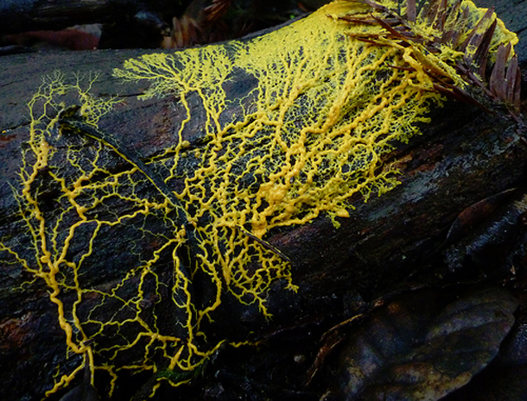
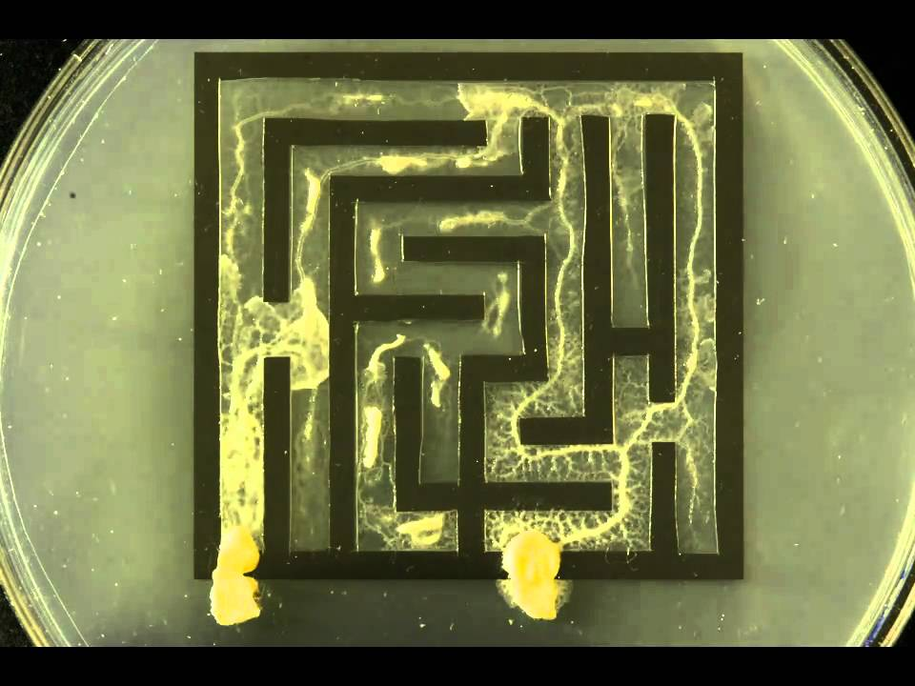
List the characteristics that all living things share
By the end of this unit you will be able to…

Slide 3
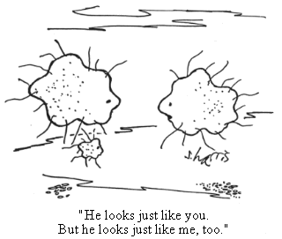
Compare the different methods organisms use to perform life functions

Slide 4
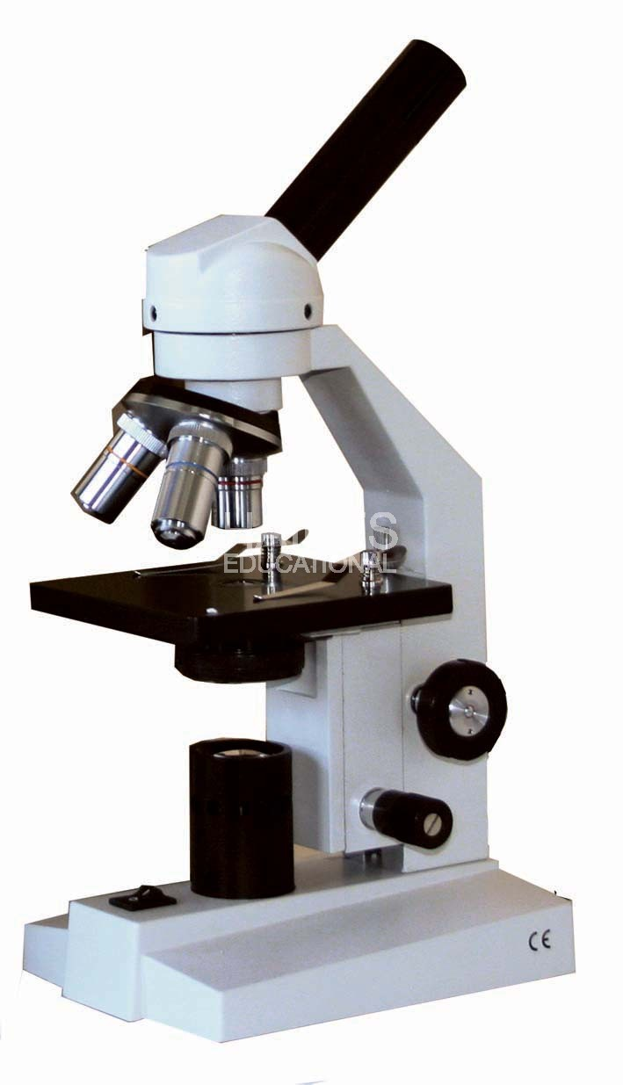
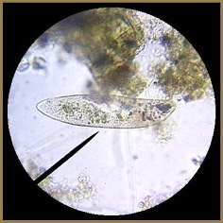
Use a microscope and calculate the size of the specimen being viewed

Slide 5
Identify the parts of a cell and describe their function

Slide 6
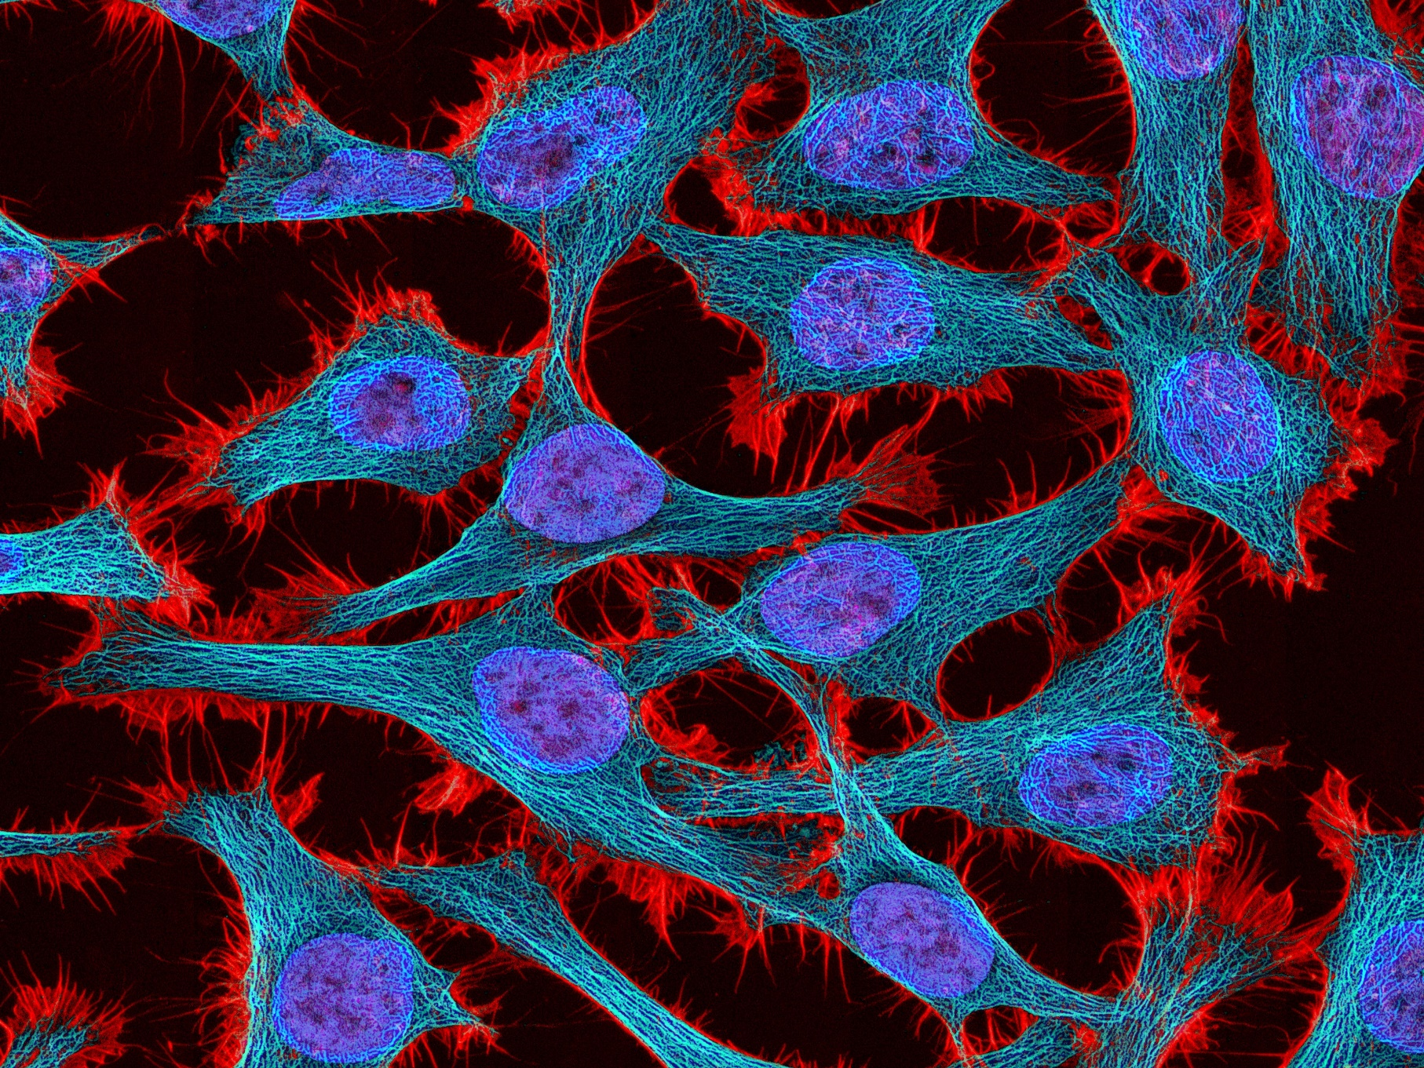
Contrast cells of differing types

